Slide 1

🛡Phishing Awareness Training: Stay Safe from Cyber Threats!
Presented by: Minisha Muthukumar

Slide 2
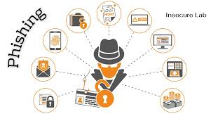
Understanding Phishing – The Digital Bait
What is Phishing?
A cyber-attack technique where attackers impersonate legitimate entities to steal sensitive information such as passwords, banking details, and personal data.
How Does It Work?
Fake emails, messages, or websites trick users into revealing credentials.
Attackers use social engineering
to manipulate trust.

Slide 3
Types of Phishing Attacks
Email Phishing – Fake emails from trusted brands asking for login details
Spear Phishing – Targeted attack on individuals using personalized details.
Whaling – High-profile attacks on executives (CEO fraud).
Smishing & Vishing – SMS-based and voice-call phishing.
Clone Phishing – Duplicate copies of real emails with malicious links.
Evil Twin Attacks – Fake Wi-Fi networks that steal user credentials.

Slide 4
How to Identify Phishing Emails & Messages
Suspicious Sender – Check for spoofed email addresses.
Urgency & Fear Tactics – "Your account will be locked in 24 hours!“
Spelling & Grammar Errors – Poor language use indicates a scam.
Fake URLs & Attachments – Hover over links before clicking!
Unusual Requests – Asking for sensitive data or money transfers.

Slide 5
Advanced Phishing Techniques & Case Studies
Business Email Compromise (BEC):
Attackers hijack business email accounts to demand money transfers.
Example: Toyota lost $37M in 2019 due to a sophisticated BEC attack.
Deepfake Phishing:
AI-generated video calls & voice recordings impersonate executives.
Example: Attackers used a deepfake CEO voice to steal $243,000!

Slide 6
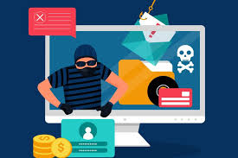
How to Protect Yourself & Your Organization
Multi-Factor Authentication (MFA) – Even if credentials are stolen, MFA blocks access.
Email Security Tools – AI-driven spam filters & phishing detection software.
Regular Security Training – Phishing simulation exercises for employees.
Password Managers – Helps create strong, unique passwords.
Zero Trust Security – Never trust, always verify users and devices.
AI-Based Threat Detection – Uses machine learning to detect phishing patterns.

Slide 7
What to Do If You Get Phished?
DO NOT click links, reply, or download attachments!
Report It – Notify your IT/security team or report at phishing.gov
Change Your Passwords – Use a password manager to create unique passwords.
Enable MFA – Prevents hackers from accessing accounts.
Educate Others – Inform colleagues and friends about the attack.

